Slide 1
OpenCV Detection of Coin Denominations
Jared Hayes
12/3/14

Slide 2
Introduction
Cross-compile on BeagleBone Black to create C++ application
Utilize OpenCV libraries to apply edge detection to an image/video of coins
Detect and outline edges of various coins
Distinguish between various denominations of coins and determine monetary value

Slide 3
Background
OpenCV is a library of programming functions that aides in the processing and analyzing images/videos

Slide 4
Tools
BeagleBone Black rev. c
16GB microSD
Logitech HD Webcam C270
Ubuntu 14.04
Eclipse
OpenCV
Remote System Explorer End-User Runtime
gcc/g++-arm-linux-gnueabi package
Hardware
Software

Slide 5
Environment - Host
Ubuntu 14.04 running on VirtualBox VM in Windows 8.1
Utilizing Eclipse IDE to cross-compile for BeagleBone Black
Allows for quicker compilation and the use of an IDE
Must use an ARM toolchain to communicate with BBB

Slide 6
Host – Setting up Eclipse for Cross Compile
Install Eclipse
sudo apt-get install eclipse eclipse-cdt g++ gcc
Install Remote System Explorer End User Runtime package in Eclipse
Install C/C++ Remote Launch plugin in Eclipse
Install Toolchain for BBB
sudo apt-get install gcc-arm-linux-gnueabi
sudo apt-get install g++-arm-linux-gnueabi

Slide 7
Host – Configure ARM Toolchain
Eclipse > Project Properties > C/C++ Build > Settings > Tool Settings
Change GCC/G++ Complier, Linker, Assembler to ARM toolchain equivalents
Library Path: /usr/arm-linux-gnueabi/lib
Include Path: /usr/arm-linux-gnueabi/include
Establish Remote Connection to BBB in Run Configurations for remote deployment

Slide 8
Environment - BBB
Angstrom – default BBB distribution, already contains OpenCV libraries
Download latest distribution http://beagleboard.org/latest-images/
Copied image in Windows using Win32DiskImager to uSD
Flash BBB
SSH into BBB
Ssh 192.168.7.2 –l root

Slide 9
BBB – Build OpenCV
Install up to date OpenCV prereqs
sudo apt‐get install build‐essential cmake pkg‐config
sudo apt‐get install libtiff4‐dev libjpeg‐dev libjasper‐dev libpng12‐dev
sudo apt‐get install libavcodec‐dev libavformat‐dev libswscale‐dev libv4l‐dev
Download OpenCV from Github
git clone https://github.com/Itseez/opencv.git
Build OpenCV
cd opencv
mkdir build && cd build
cmake ‐D CMAKE_BUILD_TYPE=RELEASE ‐D CMAKE_INSTALL_PREFIX=/usr/local ‐D WITH_CUDA=OFF ‐D WITH_CUFFT=OFF ‐D WITH_CUBLAS=OFF ‐D WITH_NVCUVID=OFF ‐D WITH_OPENCL=OFF ‐D WITH_OPENCLAMDFFT=OFF ‐D WITH_OPENCLAMDBLAS=OFF ‐D BUILD_opencv_apps=OFF ‐D BUILD_DOCS=OFF ‐D BUILD_PERF_TESTS=OFF ‐D BUILD_TESTS=OFF ‐D ENABLE_NEON=on ..
make
sudo make install
sudo ldconfig

Slide 10
Implementation - OpenCV Functions
Load an image
src = imread( argv[1], 1 );
Convert it to grayscale:
cvtColor( src, src_gray, CV_BGR2GRAY );
Apply a Gaussian blur to reduce noise and avoid false circle detection:
GaussianBlur( src_gray, src_gray, Size(9, 9), 2, 2 );
Create window
char* source_window = "Source"; namedWindow( source_window, CV_WINDOW_AUTOSIZE ); imshow( source_window, src );

Slide 11
Implementation – Hough Circles
Finds circles in a grayscale image using the Hough transform.
void HoughCircles(InputArray image, OutputArray circles, int method, double dp, double minDist, double param1=100, doubleparam2=100, int minRadius=0, int maxRadius=0 )
src_gray: Input image (grayscale)
circles: A vector that stores sets of 3 values: for each detected circle.
CV_HOUGH_GRADIENT: Define the detection method. Currently this is the only one available in OpenCV
dp = 1: The inverse ratio of resolution
min_dist = src_gray.rows/8: Minimum distance between detected centers
param_1 = 200: Upper threshold for the internal Canny edge detector
param_2 = 100*: Threshold for center detection.
min_radius = 0: Minimum radius to be detected. If unknown, put zero as default.
max_radius = 0: Maximum radius to be detected. If unknown, put zero as default

Slide 12
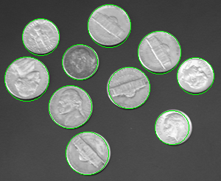
Hough Circles
Use minradius and maxradius params to filter circles outside of radius range
Adjust minDist param if not detecting all circles or detecting false circles

Slide 13
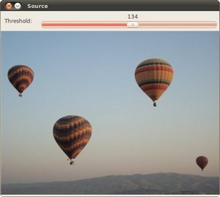
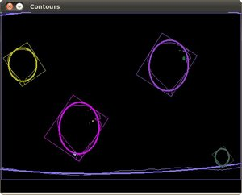
minAreaRect and fitEllipse
Uses minAreaRect and fitEllipse to find the rotated rectangle and ellipses for each contour
Used to determine diameter of drawn ellipse/circle

Slide 14
Bounding rotated boxes and ellipses
Detect Edges using threshold
threshold( src_gray, threshold_output, thresh, 255, THRESH_BINARY );
Find Contours
findContours( threshold_output, contours, hierarchy, CV_RETR_TREE, CV_CHAIN_APPROX_SIMPLE, Point(0, 0) );
Draw contours + rotated rects + ellipses
ellipse( drawing, minEllipse[i], color, 2, 8 )
for( int j = 0; j < 4; j++ ){
line( drawing, rect_points[j], rect_points[(j+1)%4], color, 1, 8 );}

Slide 15
Distinguishing Coins
Finding diameter
Rectangles drawn with line() 4 times using 4 points of rectangle stored in an array.
diam = abs(rect_points[j].-rect_points[j+1].
Measured in pixels
Pixel count of particular coins not fixed, depends on image

Slide 16
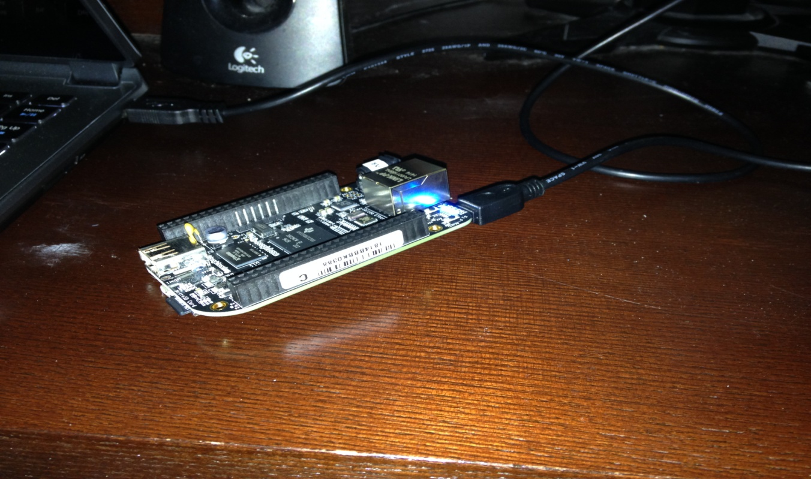
Demo

Slide 17
Conclusion
Hough Transform is sufficient for detecting non-overlapping coins of various sizes without false circles and missing circles
Distinguishing between different coins not yet implemented.

Slide 18
References
https://learn.adafruit.com/downloads/pdf/beaglebone-black-installing-operating-systems.pdf
http://www.michaelhleonard.com/cross-compile-for-beaglebone-black/
https://drive.google.com/viewerng/viewer?a=v&pid=sites&srcid=ZGVmYXVsdGRvbWFpbnx1bmx2Y3BlNDAzfGd4OmE2NDNmN2ZhMjkyYjFlZQ
http://docs.opencv.org/doc/tutorials/imgproc/imgtrans/hough_circle/hough_circle.html#hough-circle

Slide 19
Questions

